Slide 1
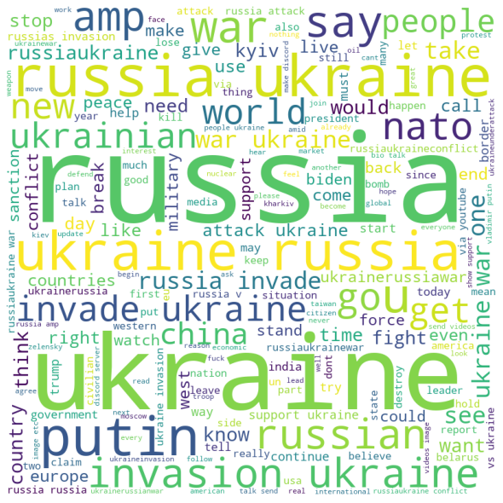
Clustering of Tweets During Russia-Ukraine Conflict
MTH514A: Multivariate Analysis Course project
Abir Naha(201257)
Arkonil dhar(201279)
Souvik Bhattacharyya(201433)
Shreya pramanik(201415)
Arkaprova Saha(201278)

Slide 2
Overall Sketch of the Project
Our objective is to form clusters of the tweets which are based on Russia-Ukraine war.
We used web scraping techniques to collect the data from Twitter API using snscrape and tweepy package in python.
Then we preprocessed the raw texts to extract numeric features from the textual data using different NLP methods.
We then applied K-Means Clustering Algorithm on the numeric data and after finding the optimum clusters we try to interpret the results.

Slide 3
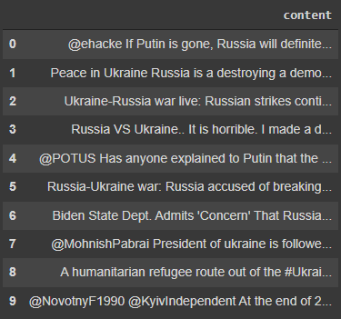
1. Web Scrapping
We have used snscrape package in python to download the tweets with keywords “russia”, “ukraine”, “ww3” etc.
We collected all the tweets containing those keywords from 24th February 2022 to 9th March 2022.
We collected a total of 2,896,731 tweets.
Figure: Snippet of 10 random samples from the dataset

Slide 4
2. Cleaning Text Data
We removed the tweets which were not in English because the stemming and lemmatization tools are only available for English.
After this we were left with a total of 943,558 tweets.

Slide 5
2. Cleaning Text Data
Step 1
Lower casing
Converted all the text into it’s lower case to maintain similarity.
Step 2
URL Removal
Any link present in the description section have been removed(e.g. Link to subscribe, link to social media handles).
Step 3
Removing Punctuation Marks and numbers
Removed these irrelevant features as these don’t add any special recognizable feature.
Step 4
Reading extra spaces between words
Otherwise it may cause problem during text transforming process.

Slide 6
2. Cleaning Text Data
Step 5
Removing Stop words
Removed frequently used words in English (e.g. He, She, is).
Step 6
Removing Emojis
Removed emojis present anywhere in the text to prevent the production of unnecessary columns during text transformation.
Step 7
Lemmatization
Reduced inflectional words to it’s root form usually having the same parts of speech as the original word.
Step 8
Stemming
Same as Lemmatization; however it reduces words to a crude heuristic form which does not necessarily have a meaning of it’s own.

Slide 7
3. Preprocessing text data: Feature Extraction
Bag of Words
N-gram
First tokenize each sentence into words and take the union of all the words to make the feature vectors.
Each feature vector represents the count of that word in a particular sentence.
E.g. “The car is beautiful” - this sentence will produce 4 features with the columns ‘The’, ‘car’, ‘is’, ‘beautiful’ and each will have a value 1 (count of the word in the sentence)
Consider all contiguous sequence of n words as feature and assign the count of the contiguous sequence in a sentence as it’s value.
Here we have choose n=2 which is also known as ‘bi-gram’
E.g. “The car is beautiful” – this sentence will produce the following features: ‘The car’, ‘car is’ and ‘is beautiful’

Slide 8
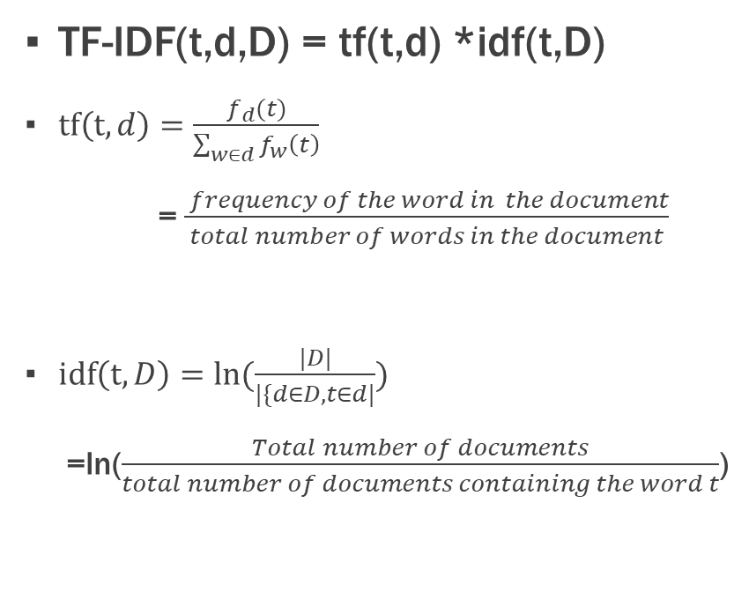
3. Preprocessing text data: Feature Extraction
TF-IDF
TF-IDF with bi-gram
TF-IDF(t,d,D) = tf(t,d) *idf(t,D)
$tf\left(t,d\right)=\frac{f_{d}(t)}{\sum_{w∈d}{f_{w}\left(t\right)}}$
= $\frac{ frequency of the word in the document}{total number of words in the document}$
$idf\left(t,D\right)=ln⁡(\frac{|D|}{|\{d∈D, t∈d|})$
=ln($\frac{Total number of documents}{total number of documents containing the word t}$)
Consider all contiguous sequence of 2 words as feature and assign the tf-idf score as its value.

Slide 9
3. Preprocessing text data: Feature Extraction
TF-IDF with Mixture of N-gram
Controlling feature count
Consider the union of all words along with all contiguous sequence of 2 words and 3 words as feature and assign the tf-idf score as its value.
Set a minimum occurrence count of a feature to 50, 10, 50, 10, 20 while feature generation for the five methods respectively.
We do this to reduce the inclusion of rarely seen words in the feature space.

Slide 10
4. Dimensionality Reduction
Due to large number of features for all the methods, we need to apply some Dimensionality Reduction Technique.
We apply PCA retaining 90% variability of the original data.
Now we are left with reasonable number of columns to work with.

Slide 11
5. Principal Component Analysis
Way of identifying patterns in data –
How input basis vectors are correlated for the given data Now we are left with reasonable number of columns to work with.
A transformation from a set of (possibly) correlated axes to another set of uncorrelated axes
Orthogonal linear transformation (i.e., rotation)
New axes are principal components
We consider the number of principal components keeping in mind the threshold of retained variance.

Slide 12
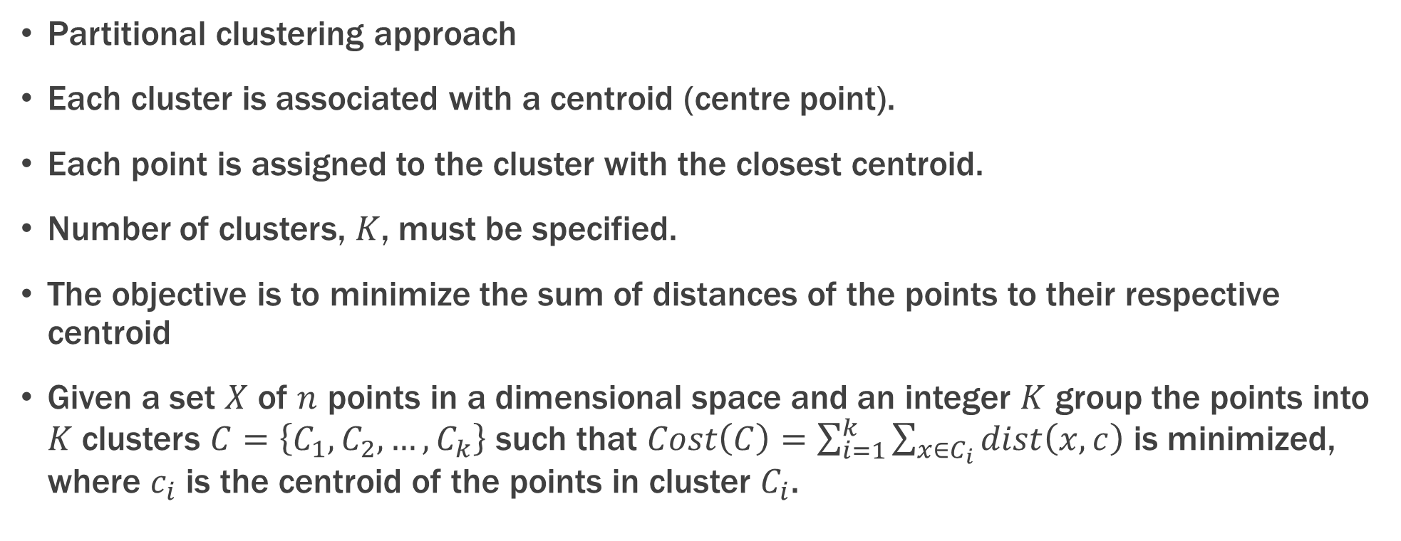
6. K-Means Clustering
Partitional clustering approach
Each cluster is associated with a centroid (centre point).
Each point is assigned to the cluster with the closest centroid.
Number of clusters, $K$, must be specified.
The objective is to minimize the sum of distances of the points to their respective centroid
Given a set $X$ of $n$ points in a dimensional space and an integer $K$ group the points into $K$ clusters $C=\left\{C_{1}, C_{2},…,C_{k}\right\}$ such that $Cost\left(C\right)=\sum_{i=1}^{k}{\sum_{x∈C_{i}}{dist\left(x,c\right)}}$ is minimized, where $c_{i}$ is the centroid of the points in cluster $C_{i}$.

Slide 13
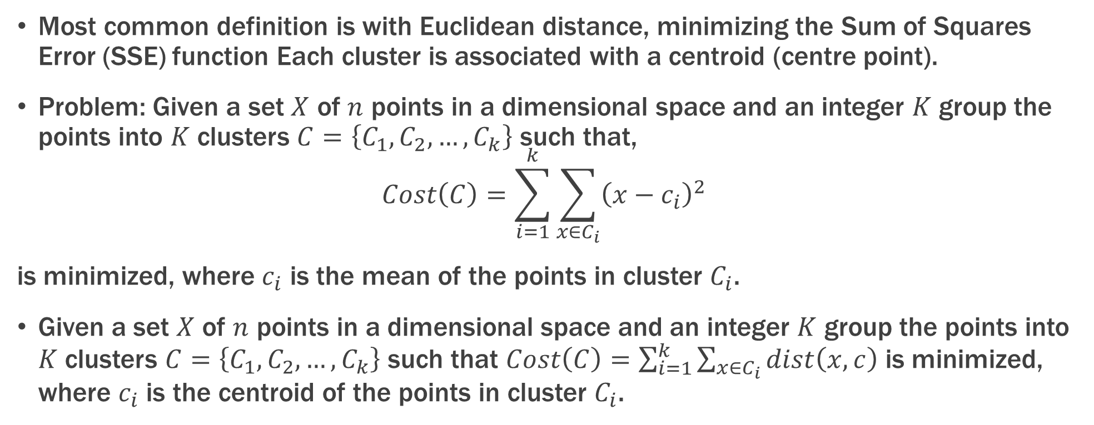
6. K-Means Clustering
Most common definition is with Euclidean distance, minimizing the Sum of Squares Error (SSE) function Each cluster is associated with a centroid (centre point).
Problem: Given a set $X$ of $n$ points in a dimensional space and an integer $K$ group the points into $K$ clusters $C=\left\{C_{1}, C_{2},…,C_{k}\right\}$ such that,
$$Cost\left(C\right)=\sum_{i=1}^{k}{\sum_{x∈C_{i}}{{\left(x−c_{i}\right)}^{2}}}$$
is minimized, where $c_{i}$ is the mean of the points in cluster $C_{i}$.
Given a set $X$ of $n$ points in a dimensional space and an integer $K$ group the points into $K$ clusters $C=\left\{C_{1}, C_{2},…,C_{k}\right\}$ such that $Cost\left(C\right)=\sum_{i=1}^{k}{\sum_{x∈C_{i}}{dist\left(x,c\right)}}$ is minimized, where $c_{i}$ is the centroid of the points in cluster $C_{i}$.

Slide 14
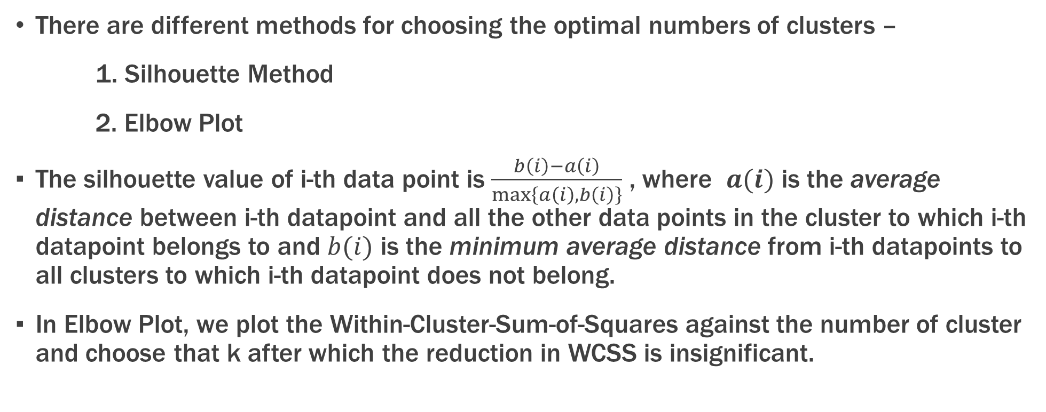
7. Choosing Optimal K in K-Means Clustering
There are different methods for choosing the optimal numbers of clusters –
1. Silhouette Method
2. Elbow Plot
The silhouette value of i-th data point is $\frac{b\left(i\right)−a\left(i\right)}{\max\left\{a\left(i\right), b\left(i\right)\right\}}$ , where $a(i)$ is the average distance between i-th datapoint and all the other data points in the cluster to which i-th datapoint belongs to and $b(i)$ is the minimum average distance from i-th datapoints to all clusters to which i-th datapoint does not belong.
In Elbow Plot, we plot the Within-Cluster-Sum-of-Squares against the number of cluster and choose that k after which the reduction in WCSS is insignificant.

Slide 15
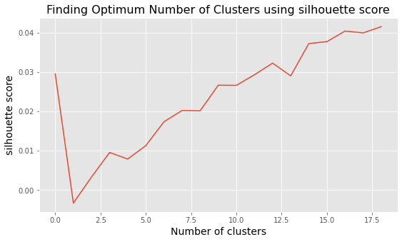
7. Choosing Optimal K by silhouette method
Bag-of-Words method

Slide 16
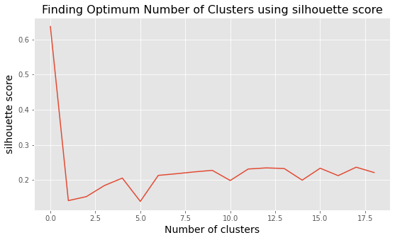
7. Choosing Optimal K by silhouette method
N-gram method

Slide 17
7. Choosing Optimal K by silhouette method
TF-IDF method

Slide 18
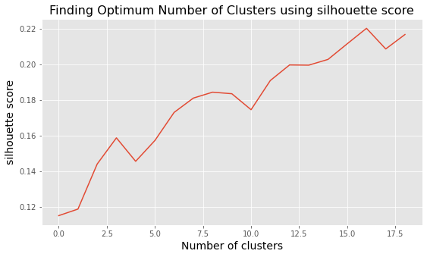
7. Choosing Optimal K by silhouette method
TF-IDF n-gram method

Slide 19
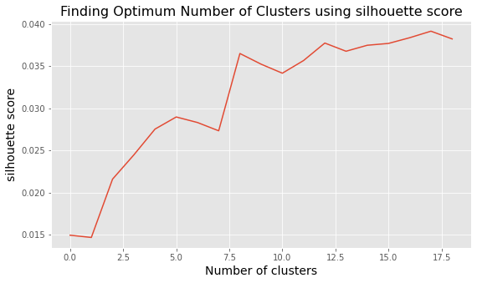
7. Choosing Optimal K by silhouette method
TF-IDF mixed n-gram method

Slide 20
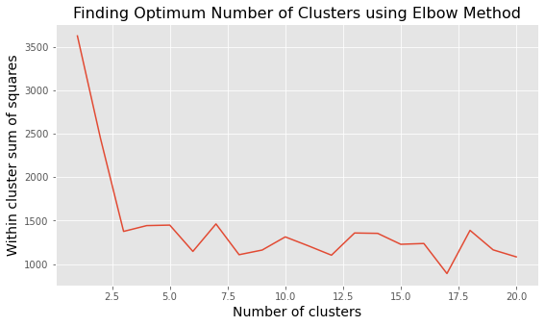
7. Choosing Optimal K by elbow plot
Bag-of-Words method

Slide 21
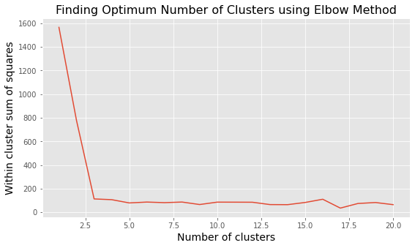
7. Choosing Optimal K by elbow plot
n-gram method

Slide 22
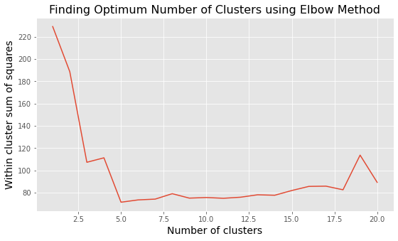
7. Choosing Optimal K by elbow plot
TF-IDF method

Slide 23
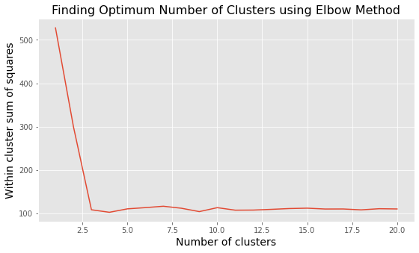
7. Choosing Optimal K by elbow plot
TF-IDF n-gram method

Slide 24
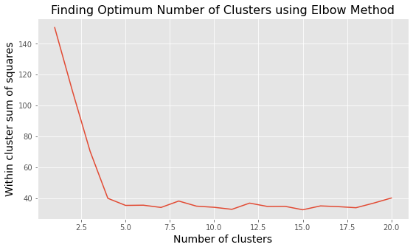
7. Choosing Optimal K by elbow plot
TF-IDF mixed n-gram method

Slide 25
8. Tweets from Cluster 2
Joining Apple and others, Microsoft stops sales in Russia amid invasion: 'We stand with Ukraine'
Russia Ukraine war: Will Russia use nuclear weapons?
Expectations are low but hopes are high and Ukraine and Russia sit down and discuss steps to ending this war!

Slide 26
8. Tweets from Cluster 1
The population of the United States is growing and we the people of the United States need more fertile land. Now that the opportunity is knocking at our door. Letâ€™s take Russia and all its land! The Ukraine can
I hope the war between Russia and Ukraine will end soon But why has the world forgotten Yemen????!!! Today is 2535th day of the war in Yemen.­ @UN #UkraineRussia #Yemen
@PMOIndia @narendramodi Our govt. Stand on this war is very clear and logical. Those who don't understand, just think who is Ukraine? and Russia. What was their stands towards india. Answer is simple. Russia and prez. putin Rocks "Akhand bharat" ka sapna ab dur nahi.˜€ #BREAKING #RussiaUkraineWar

Slide 27
8. Tweets from Cluster 3
Infact this war is being fought between Russia and USA, They both choose Ukraine as a battleground . #NATO
It's because they are not like USA who would have killed already hundreds of thousands at this stage Russia is considering a big part of Ukraine as ethnic brothers. The goal is to destroy the infrastructure of NATO
@dhruv_rathee So ladies and gentlemen welcome to the world of pseudo activism, Not a single tweet or video on how Indians and Africans are being mistreated and did back-to-back videos on how Russia invaded Ukraine. Not a single video on US bombing Somalia oh I forgot they are not whites

Slide 28
Thank You
Limitations:
Worked only with 15 days of tweets.
Used only English Tweets.
Resources:
NLP videos by Krish Naik from YouTube
Wikipedia and Medium website
Multivariate Analysis Class Notes of Dr. Minerva Mukhopadhyay

